Slide 1
CS561 Final
Caleb Elliott

Slide 2
#1
A
| keyOfA | attrOfA | derivedAttr
WEAK
| attrOfWk | partialKey | keyOfA

Slide 3
#2
C
| keyOfC | attrOfC | multiKey
ATTR
| multiKey | attribute1 | attribute2 | …

Slide 4
#3
B
| keyOfB | attrOfB |
bb
| child | keyOfB

Slide 5
#4
A
| keyOfA | attrOfA | abKey | baKey
ab
| abKey | attrOfAB |
ba
| baKey | attrOfBA |
B
| keyOfB | attrOfB | abKey | baKey

Slide 6
#5
A
B
C
D
L
M
N
O
E
TABLE1
K
TABLE3
12
23
F
G
H
I
TABLE3
J

Slide 7
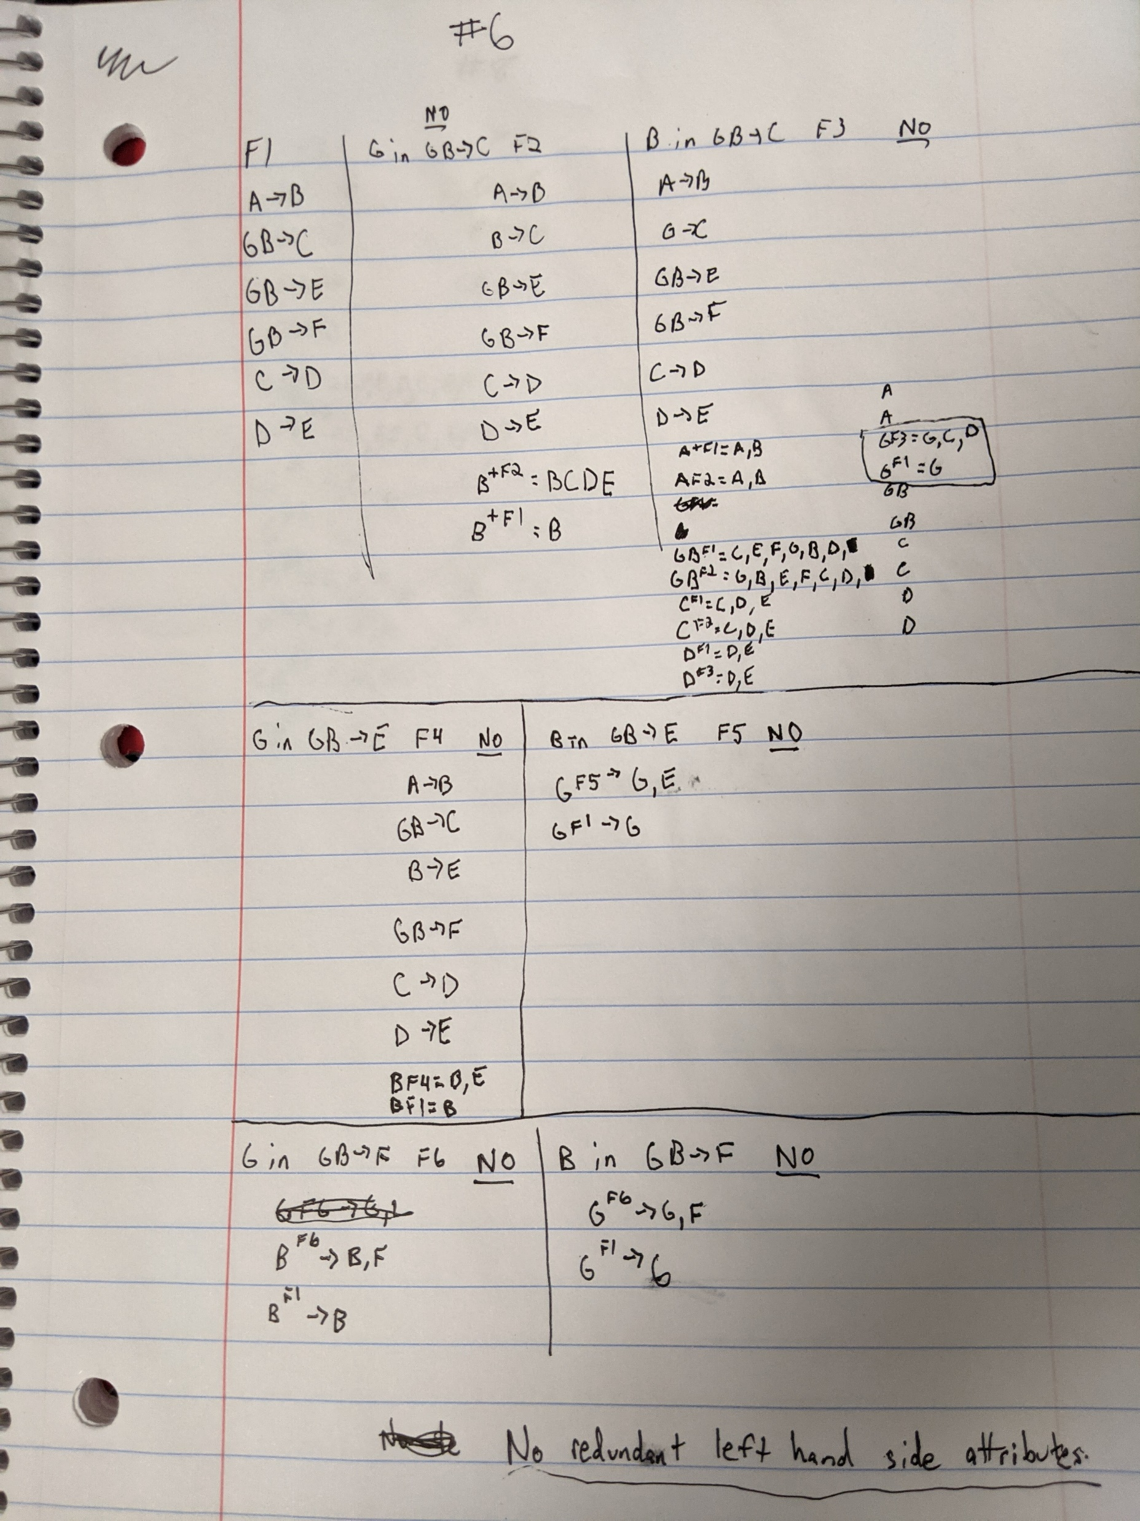
#6
There are no redundant left hand side attributes.

Slide 8
#7
Key is A,G,B since AGB = A, G, B, C, E, F, D are all the attributes of the table

Slide 9
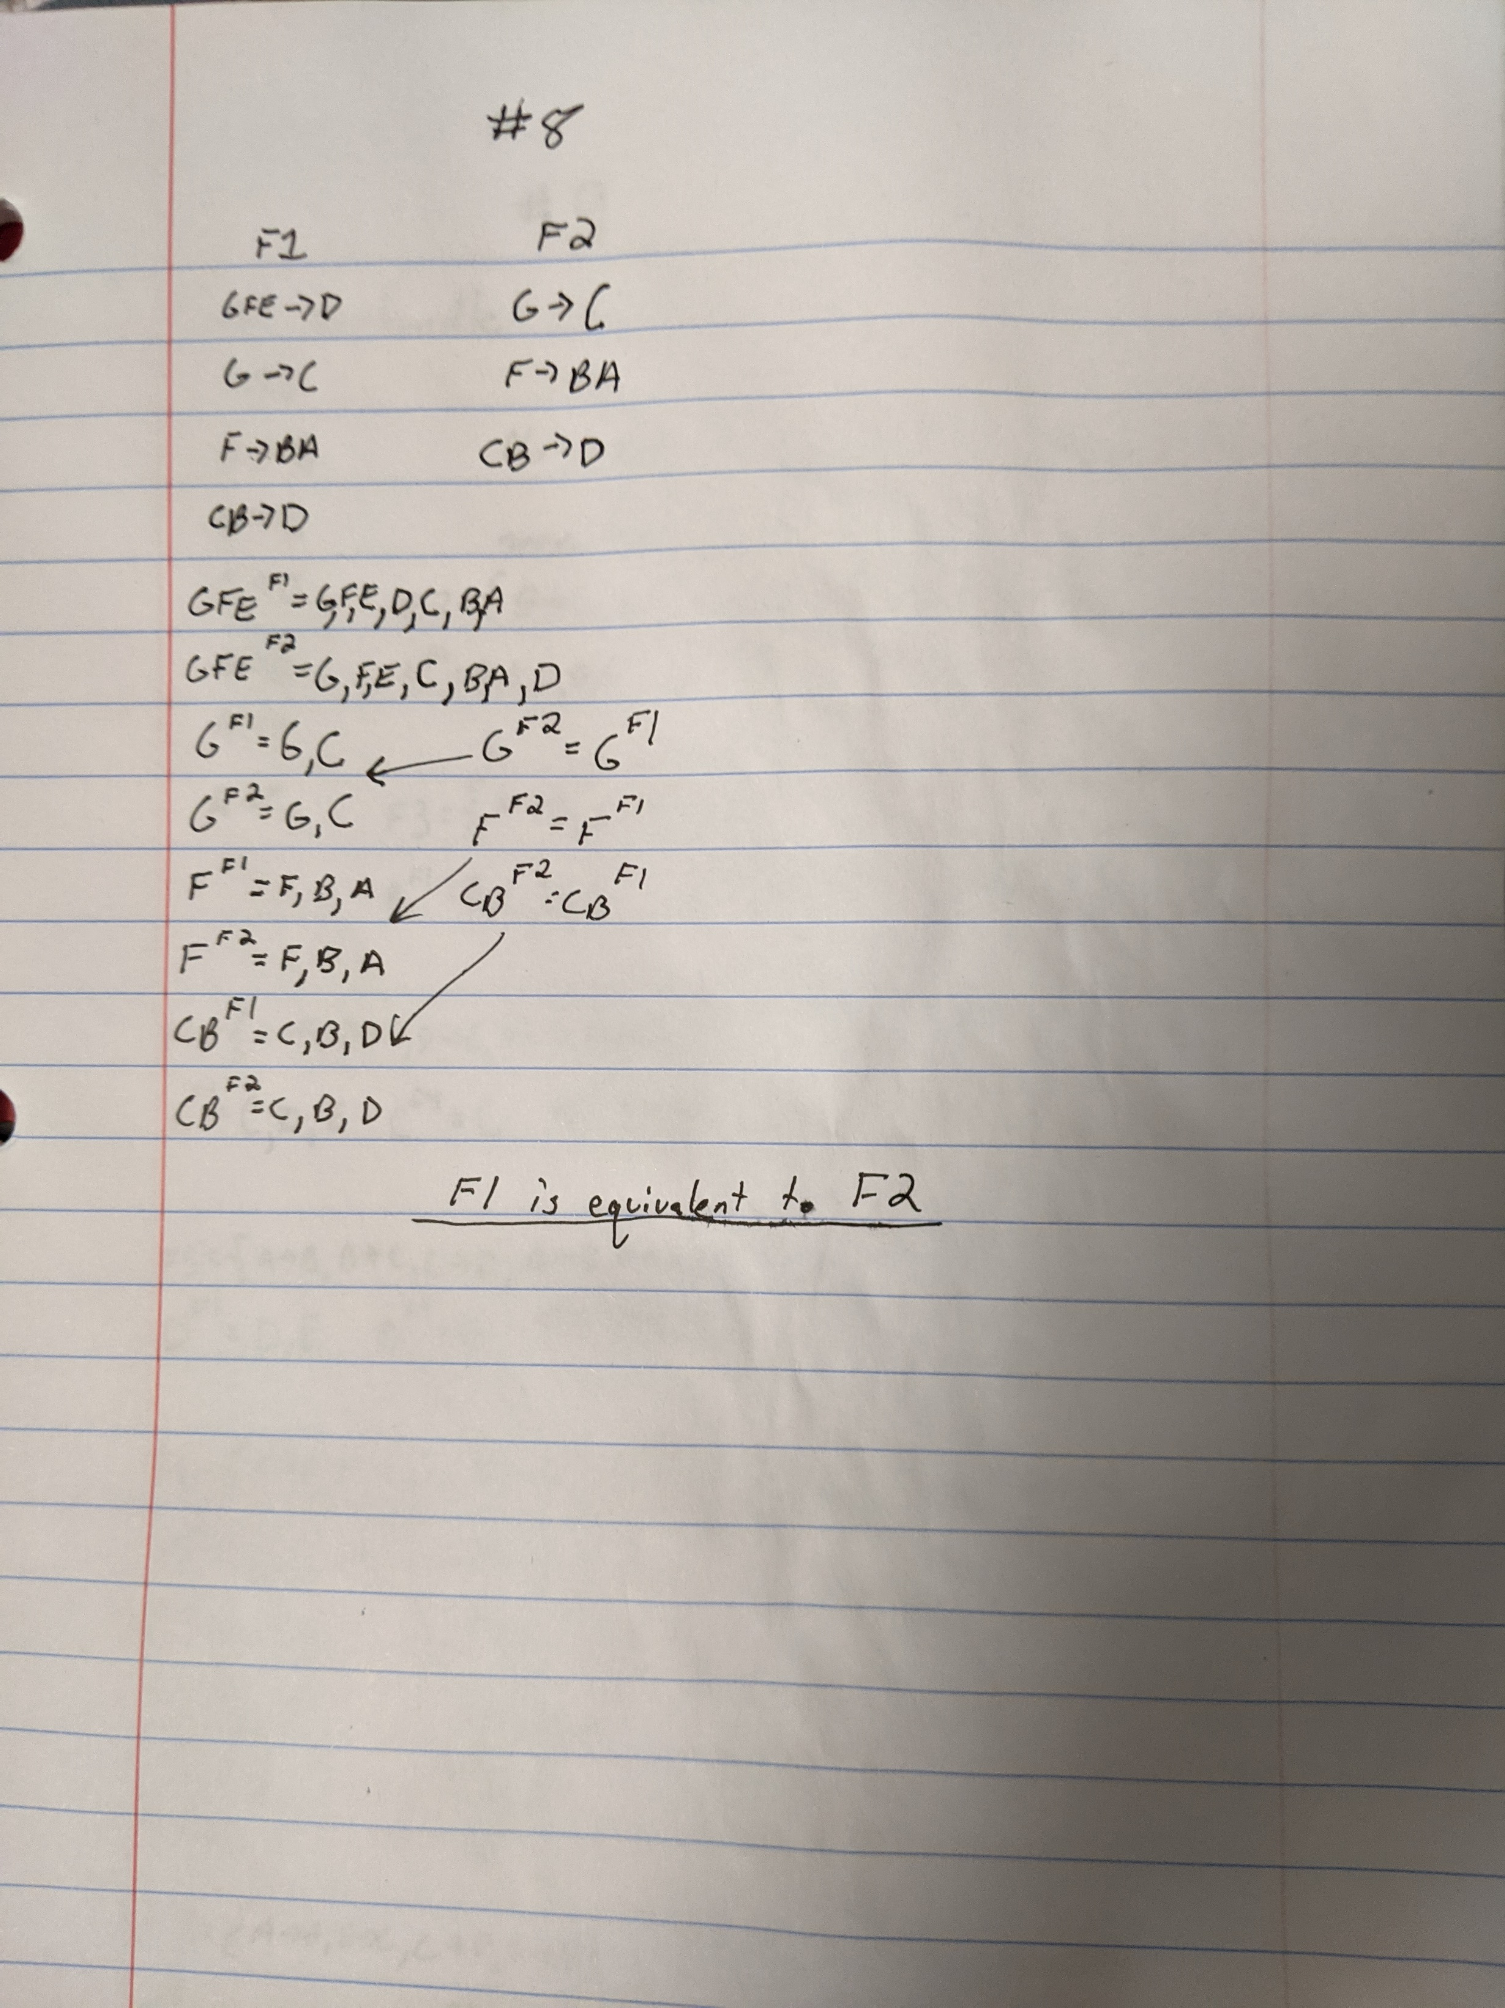
#8
F1 is equivalent to F2

Slide 10
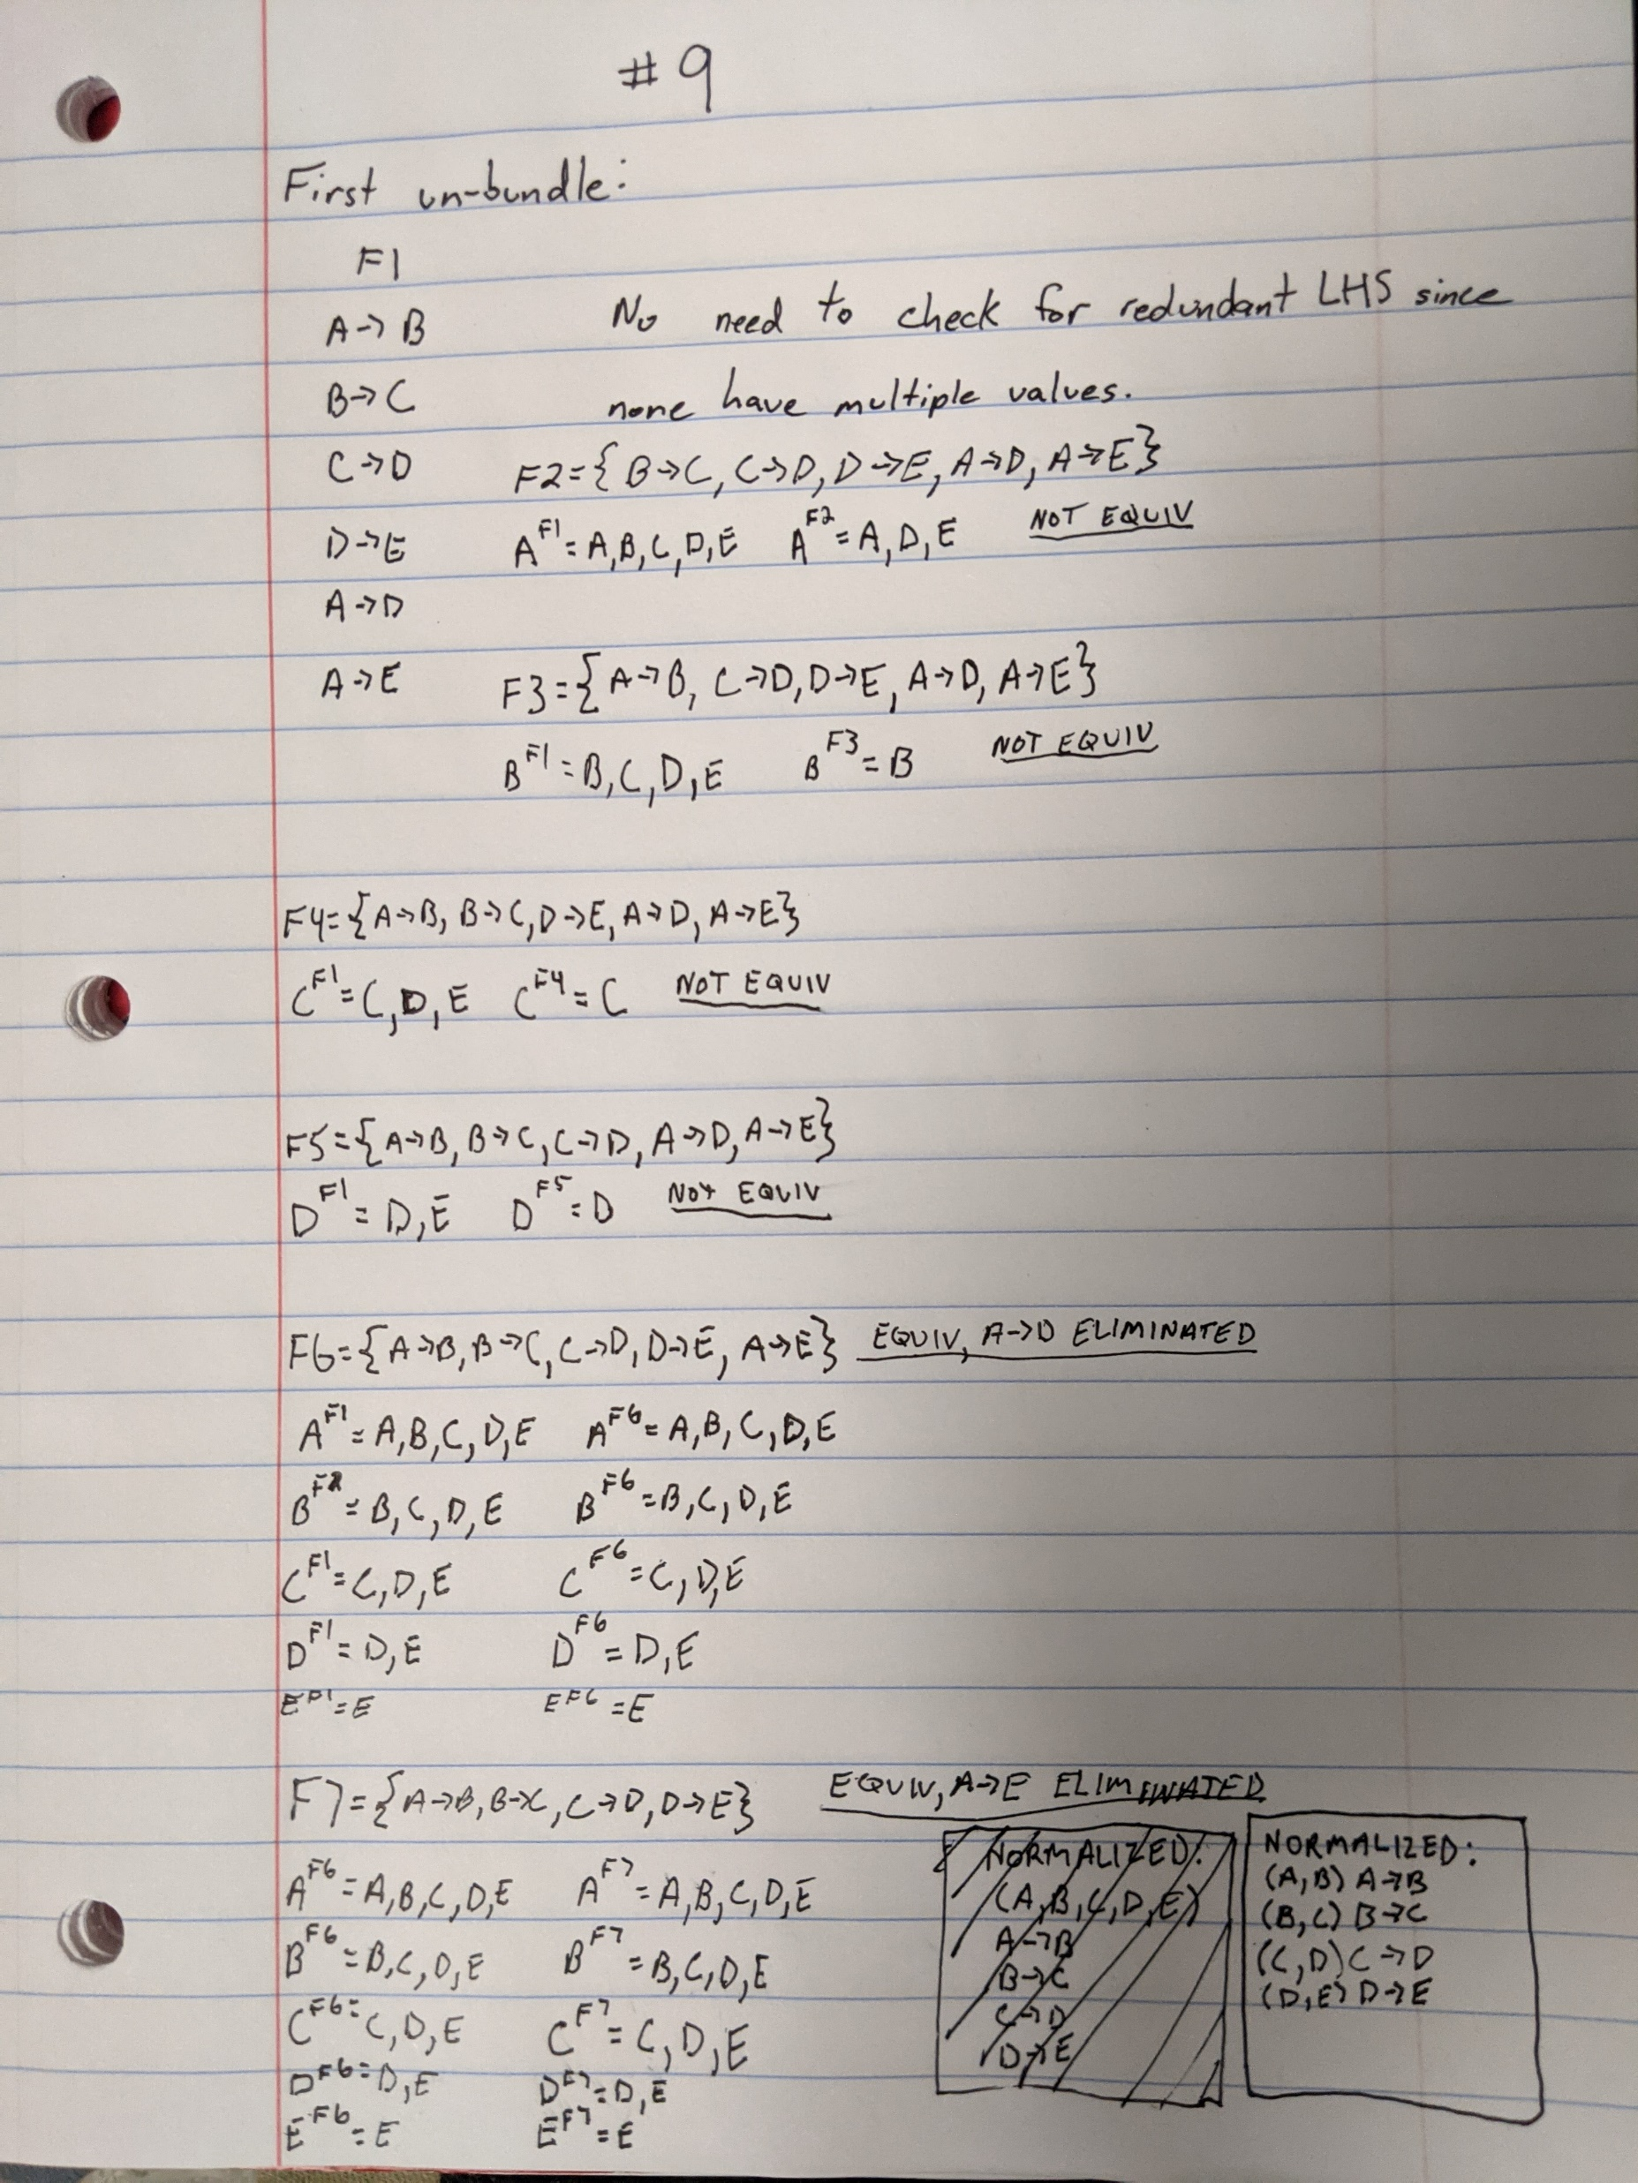
#9
Normalized:
(A,B) A->B
(B,C) B->C
(C,D) C->D
(D,E) D->E

Slide 11
#10
(A, B) A->B
(B, C) B->C
(C,D) C->D
(A, E, F) (A foreign key reference to (A, B))

Slide 12
#11
(A, B, C) A->BC, B->A
(C,D) C->D

